Slide 1
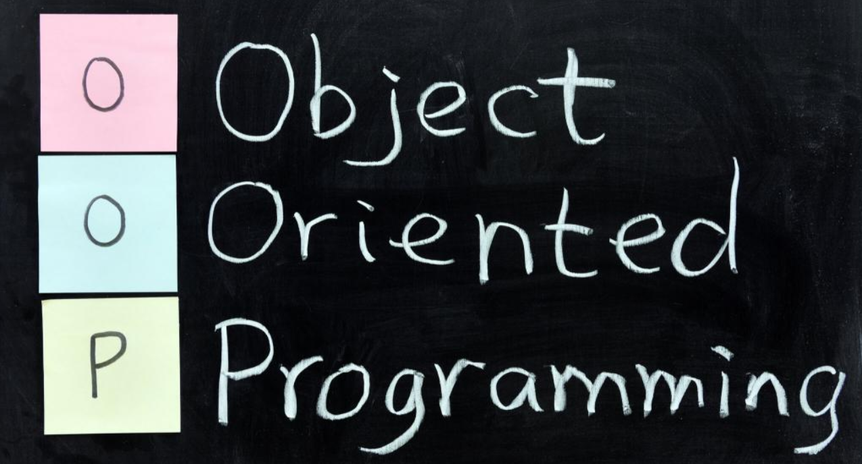

Slide 2
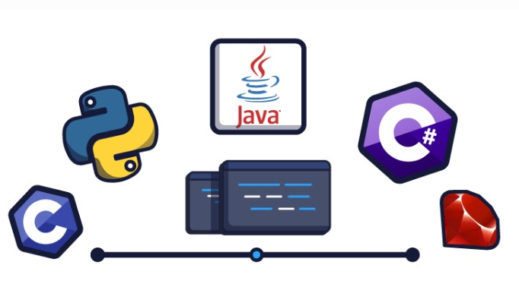

Object Oriented Programming?
Object Oriented Programming concept is a way of programming in which every possible agent is broken down into elements called “object”. i.e. It is oriented around entity called objects which are basically models of the real world.
Some examples of OOPL are Python, Ruby, C# etc.

Slide 3
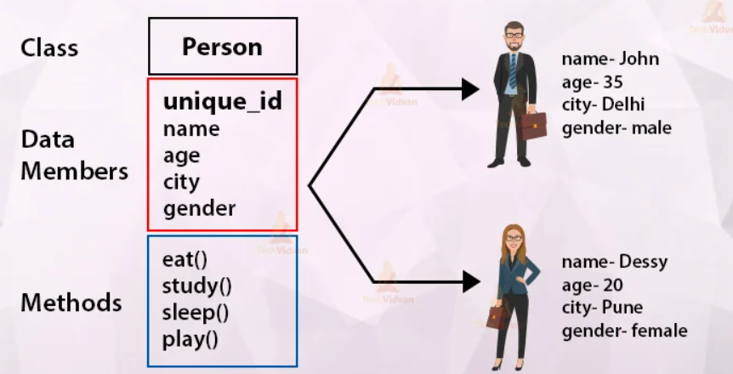
Basic Element of OOP
The most basic element in OOP are classes. They are the blueprint for objects. Whenever we need to create objects, we invoke classes.
Class consist of “attributes” that define characteristics of objects and “functions” that define what task can the object perform.

Slide 4
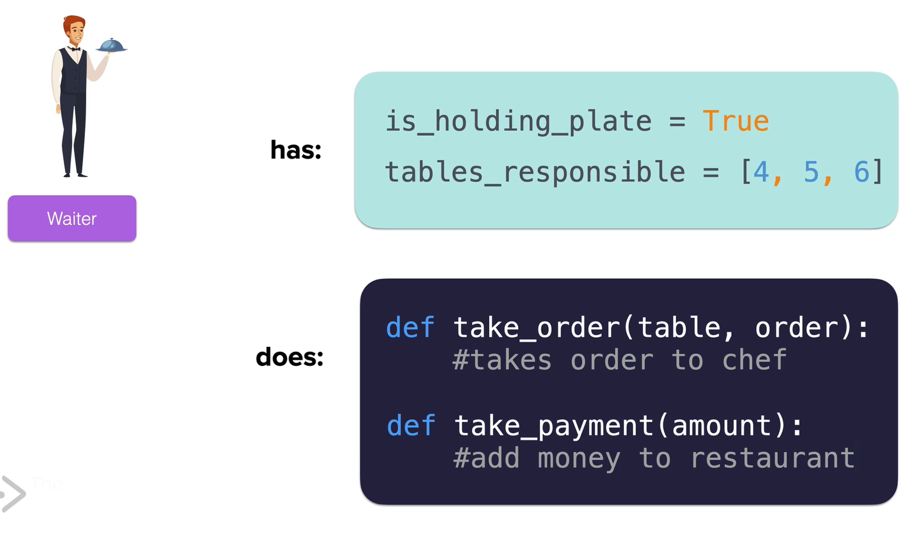

Object & Class Intuition
Here, Waiter is a class

Slide 5
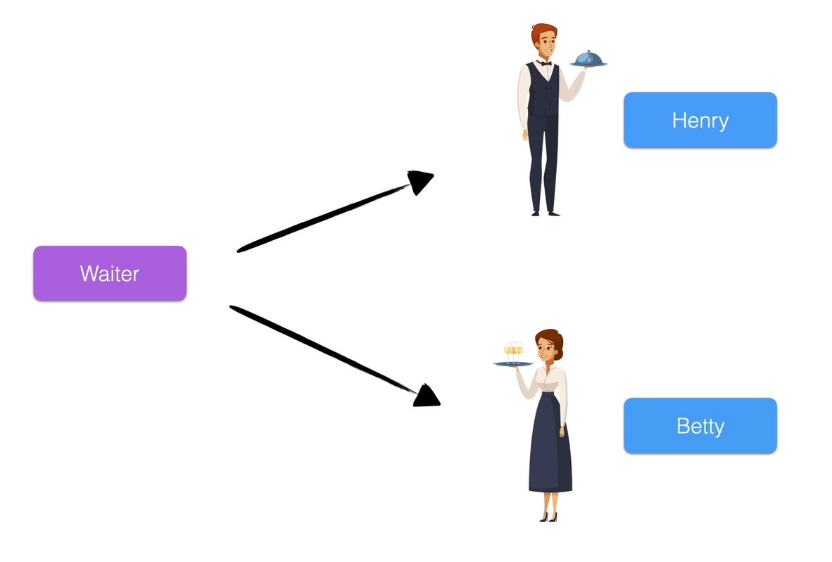
Object & Class Intuition
Object
Class
Object

Slide 6
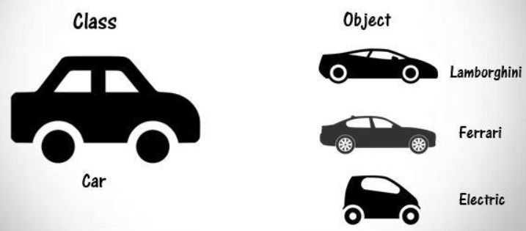
Object and Class Intuition
The blueprint is called class.
The entities created using class are called objects.

Slide 7
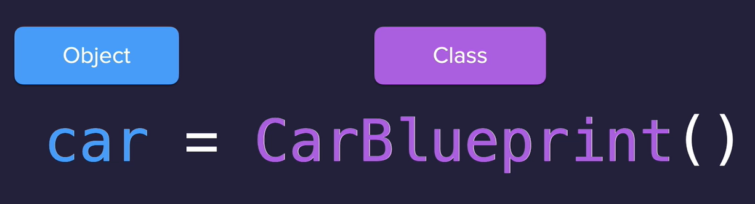
Example of how classes are invoked in Python

Slide 8
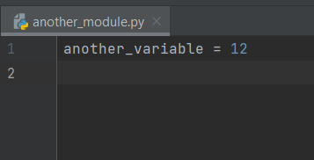
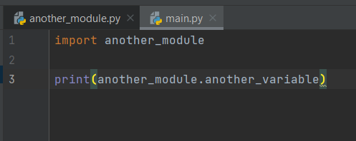
Let’s have a look at a basic example:
Initially we created a file and named it “another_module.py” and
create a variable and give it a value.
Now, we created a new file called “main.py” and imported “another_module.py” using “import” command.
After importing, we now can use variables inside “another_module.py” in “main.py” as shown below:

Slide 9
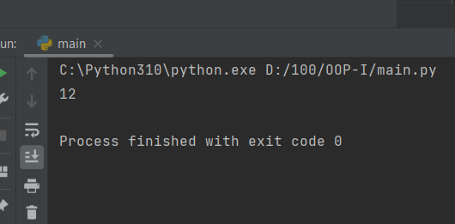
The output we get is :

Slide 10
What are python packages?
Python packages are the modules that other developer wrote. We can import that and use the functions to perform desired work.
How can we import those packages into our project?
First, we need to install them into our PC.
And then we need to import them into our project.

Slide 11
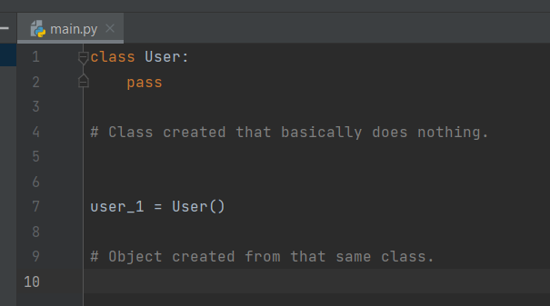
But, how can we create our own python class??
When have our own class, we can build our own objects and work with them.
So, How do we do it?
First, we start with class keyword and give our class the name. i.e. “class <classname>:”

Slide 12
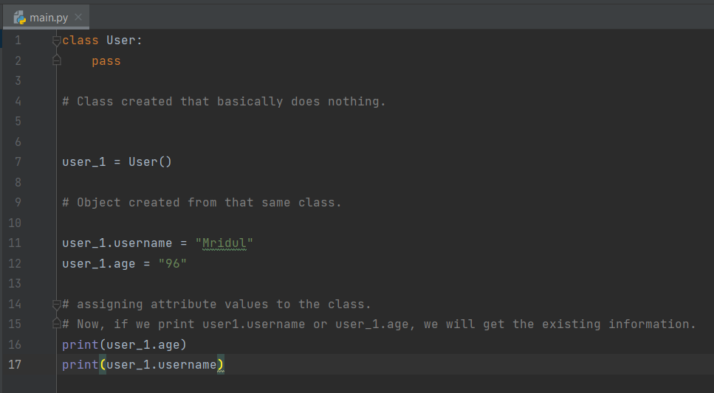

Slide 13
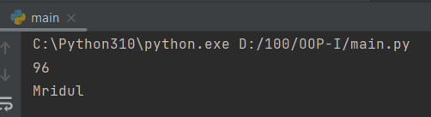

Slide 14
Now, the method we used previously is very error prone and there is high chance that we will make basic errors which will slow down the development process.
So, how can we minimize the error???
We can achieve that by something called Constructor.
so, what exactly is this constructor???
Constructor is basically the part of the blueprint that allows us to define what should happen when our object is being created.
In programming languages, this is also called initialization of object. i.e. While initializing the object, we can set the starting values for attributes.
In python we create constructor by using a special function called “__init__”

Slide 15
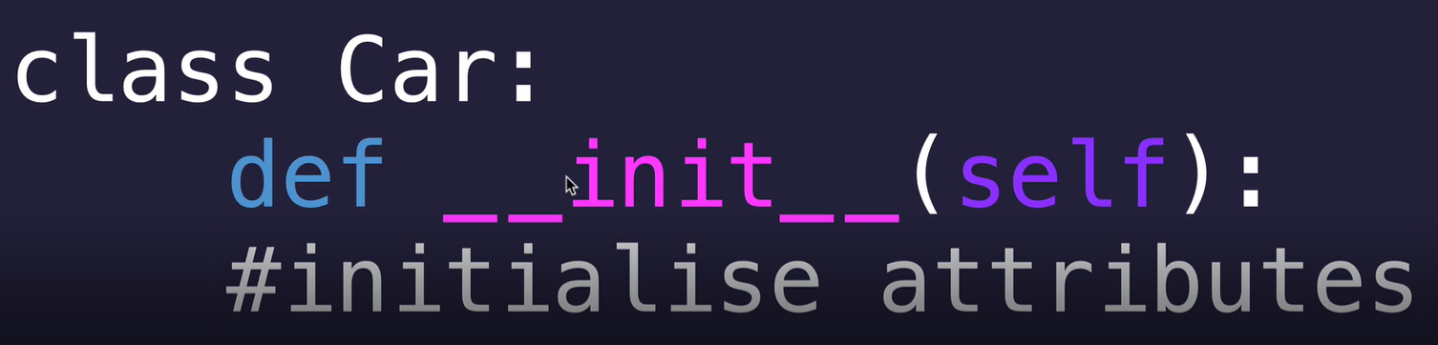
Note :
“__init__” function is going to be called everytime we call a class.

Slide 16
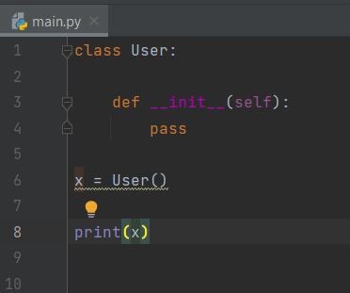
Let’s look at example of constructor:

Slide 17
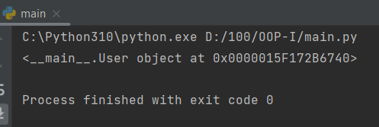
Output of previous program is :
“__main__.User object at 0x0000015F172B6740” means that the object is created at that specific location from class User

Slide 18
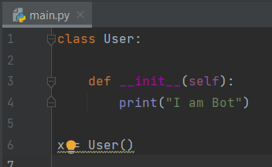
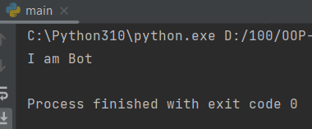
Previously we have said that the constructor is executed everytime we create an object no matter what. Let’s look that in practice.
Output for this is:
We can see that our object is created and the constructor is executed as well.

Slide 19
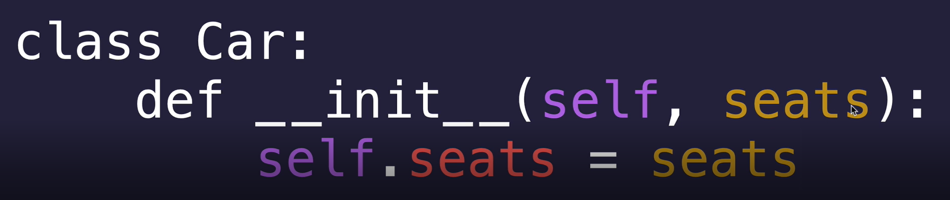
We can also make the class to take parameters while creating object so that we can create many object with different attributes while initializing an object. We can add as many parameters as per need.
We can achieve this by just adding parameters in “__init__” function and using self.<variable_name>=<parameter_name>

Slide 20
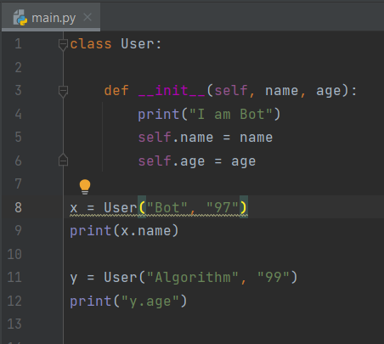
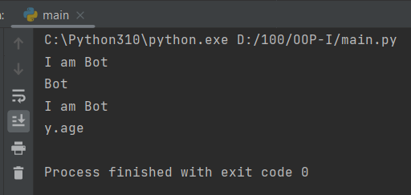
Let’s look at the example:
It’s output is:
We can see that the constructor is called and executed everytime we create a new object.

Slide 21
Thank You!!!

